Slide 1
Job Seeking Experience
Sharing Session

Slide 2
Overview
Applying for Job
Preparing for interviews
The interview experience
Career Advices

Slide 3
What skills do you seek in your fresh graduate recruits? (please choose top 4)
Leadership
Teamwork
Analytical thinking
Technical/Legal Knowledge
Initiative
Interpersonal skills
Creative Problem Solving
Drive
Communication Skill
Language proficiency

Slide 4
70.91%
67.27%
56.36%
60%

Slide 5
Applying for a Job
Use a Professional Email Address
Write an Informative Subject Line
Subject: Name of Applicant – Name of Position, Job Reference Number/Job Applied
Be Focused and Brief
“I came across a very exciting position on your job portal that I believe fits me perfectly. I am interested in applying for the position of Legal Officer (Job Reference Number A123) at Sony Electronics”
Use Only a Formal Greeting and Closing
Dear Mr./Ms. Last Name, Dear Sir/Madam - Sincerely, Regards
Include a Professional Electronic Signature
Your Name - Your Address - Your Email - Your Phone Number
Always Add Relevant Attachments
Double Check Everything

Slide 6
Ideal CV
Personal Information
Education Background
Work Experiences
Skills: Certifications & Organizations
Honors / Awards

Slide 7
Preparing for Interviews
Prepare your Appearance
What to wear
Other little things – fragrance, cleanness, jewellery
Check the Location (or test your technology beforehand)
Choose a room that is clean and professional-looking (virtual interview)
Review your skills, experiences and qualifications
Check CV, Anticipate questions and identify relevant examples
Prepare key selling points
Research the company/firm
Websites, reports, articles, contacts with knowledge of the company etc
Research job and occupational area
Job description – or similar
Current issues
Prepare your questions
Practice

Slide 8
The Interview Experience
Be on time
Familiarize yourself with your surrounding
Bring extra copy of your CV
Be polite everyone you meet from the time you walk in the door to when you leave
Introduce yourself
Watch your body language (eye contact, handshake)
Keep your introduction short & concise
Focus on qualifications
Be prepared for follow-up questions
Keep all of your mobile and other electronic devices turned completely off or in silent mode.
REMEMBER: Manners Matters

Slide 9
Answering Interview Questions
Ask for clarification if needed.
Be honest. Never embellish your past accomplishments or claim a skill you do not have.
Stay true to your message. Focus on the reasons the company should hire you; Use the STAR method whenever possible.
Always answer questions with your audience in mind.
Avoid topics that can get you into trouble. These typically include things in your personal life, such as your marital status, age, religion, or political beliefs.
Use clear and concise language. Speak slowly and carefully to make sure your words are being understood. Pause when necessary
Seek feedback. Ask the hiring manager if you have provided the level of detail needed to fully answer the question.
REMEMBER: Watch your Body Language

Slide 10
STAR Model Methodology
Star model is a framework to present information that reveals skills, knowledge and approach to situations at work
Situation
What was the specific SITUATION, or context?
Task
What was your responsibility or task?
What challenges did you face?
Action
What ACTION did you take?
Result
What was the RESULT? What did you learn from this experience?
Notes:
A tool to help probe effectively is the STAR models which can also help the candidate communicate his/her experience and verify their responses
Once a behavioral based question is asked, there are 4 elements that employer should look at to help determine the validity of candidate’s answer.
Situation
Task
Action
Result
The aim of interviewer, is to ask specific behavioral based questions to help candidates respond in the STAR framework.

Slide 11
Please choose top 4 traits you look for during a job interview
Candidate understanding of the company/firm and what it does
Candidate possess career goals and direction
Candidate exhibits ambition and passion
Candidate demonstrates leadership abilities
Candidate displays confidence about who they are and what they bring to the company
Candidate attitude and body language
Candidate capability of exercising ethical judgement and integrity
Candidate ability to communicate in English

Slide 12
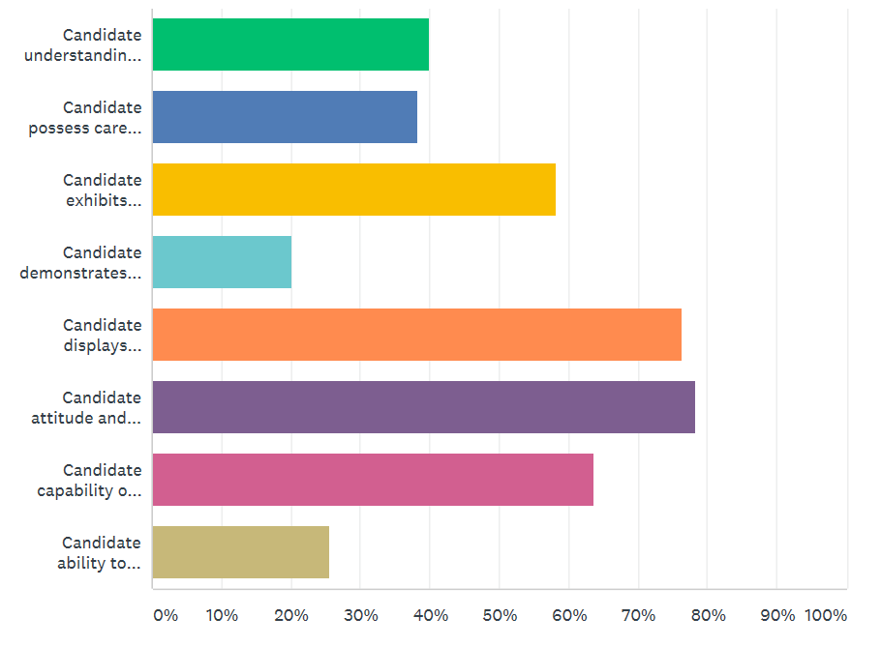
58.18%
76.36%
78.18%
63.64%

Slide 13
Please choose 4 actions that candidate did during the interview process that you find disturbing
Displaying a lack of confidence
Failing to maintain a professional appearance
Exhibiting bad manners
Focusing on salary & benefits instead of the job
Be late or way too early
Talking Too Much
Answering a mobile phone or text during the interview
Dressing inappropriately
Blaming others for their mistakes
Appearing arrogant

Slide 14
81.82%
63.64%
63.64%
60%

Slide 15
Let’s Practice
Questions
Describe a situation where you used your leadership skills to solve a problem
Tell me about something you accomplished that you are proud of.
Give an example of a goal you reached and tell me how you achieved it.
Give an example of how you worked on a team.
Tell me about a mistake you made at school or work, and what you learned from it.
Why did you select your college or university?

Slide 16
Career Advices
Attitude is everything
Be open minded, be patient, listen & learn from others
Work hard, ask when uncertain, never assume
Be humble
Be passionate and well rounded about your given assignment in your first job.
Do not be afraid to make mistake
Have purpose and passion, find a job that would serve them
Be active
Be passionate and driven to learn many things as you can.

